Slide 1

Desing Patterns Applied to Pac man game

Slide 2

Design pattern State:
This pattern is used to model states and transitions between them. In the case of Pac-Man, you can define states such as "eating a dot", "chasing a ghost", "running away from a ghost", among others. Each of these states has a specific behaviour and logic, and the State pattern allows you to change states in an orderly and efficient way.

Slide 3
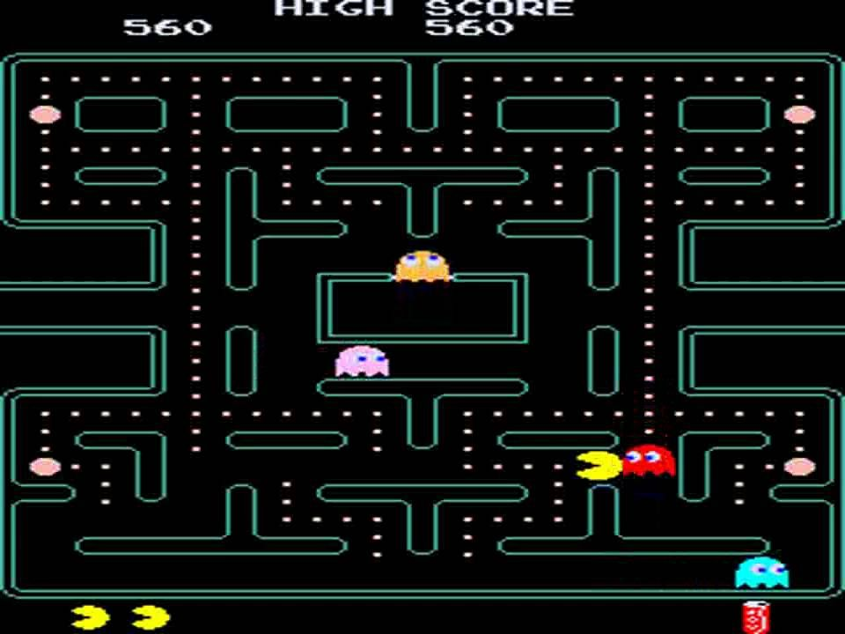
Strategy design pattern:
This pattern is used to define different strategies to solve a problem. In the case of Pac-Man, this pattern could be used to define different strategies for Pac-Man to evade ghosts or to eat more points in less time.

Slide 4
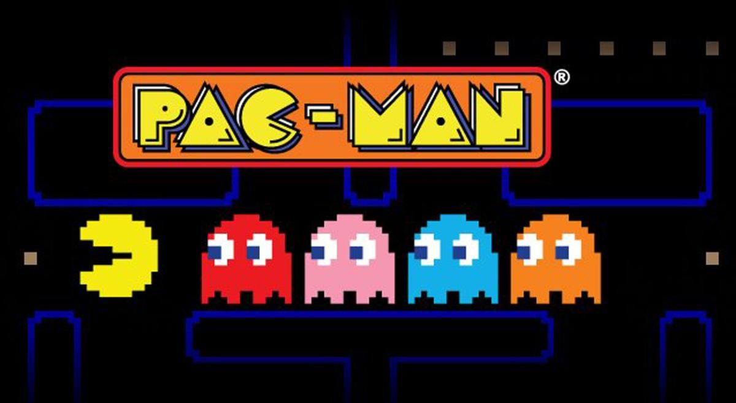
Observer design pattern:
This pattern is used to establish a dependency relationship between an object (subject) and other objects (observers) that need to be notified when the state of the subject object changes. In the case of Pac-Man, this pattern could be used to notify observers (such as ghosts) when Pac-Man has eaten a dot or when his state has changed.

Slide 5
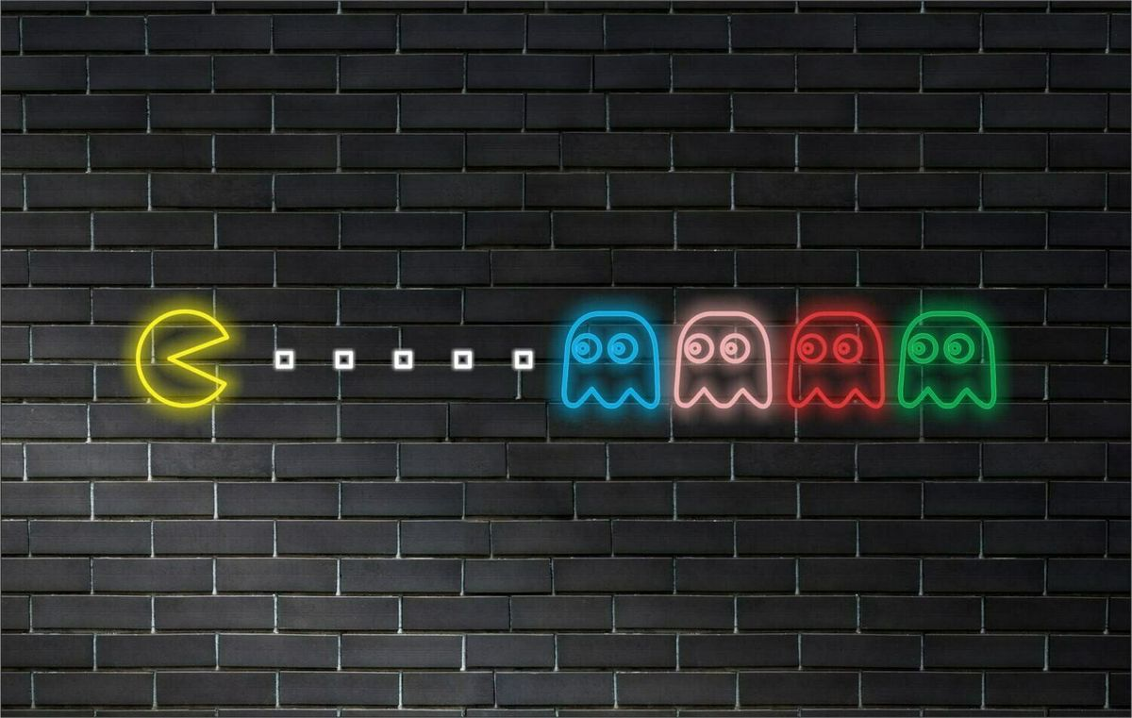
Decorator design pattern:
This pattern is used to add functionality to an object dynamically. In the case of Pac-Man, this pattern could be used to add different powers or abilities to the character (such as the ability to fly or move faster) that can be obtained by eating certain points.

Slide 6
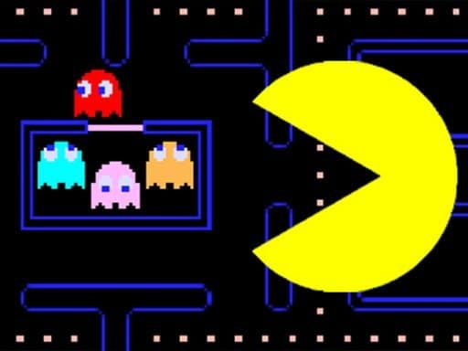
Command design pattern:
This pattern is used to encapsulate an action in an object so that the action can be invoked later. In the case of Pac-Man, this pattern could be used to encapsulate actions that the player performs (such as moving Pac-Man up or down) so that they can be executed later or to allow chain actions to be performed.

